Slide 1


SAP UI5 & FIORI with OData TRAINING using BAS
Anubhav Oberoy
Day – 9

Slide 2

Agenda – Day 9
The Route matched handler
What is OData?
oData Basics.
Structure of Odata.
Client Side Query With Odata.
Get Operations.
SAP Deployment Options
TCodes and Services
Data Model for our use case
Creating OData Service.
Building Get Entity set Method
Testing the Get Entity set Method in Browser
Building Get Entity method (Single Product)
Introduction to the Postman Tool
Setting the Authorization in Postman
Testing Get Entity and Entity set using Postman

Slide 3
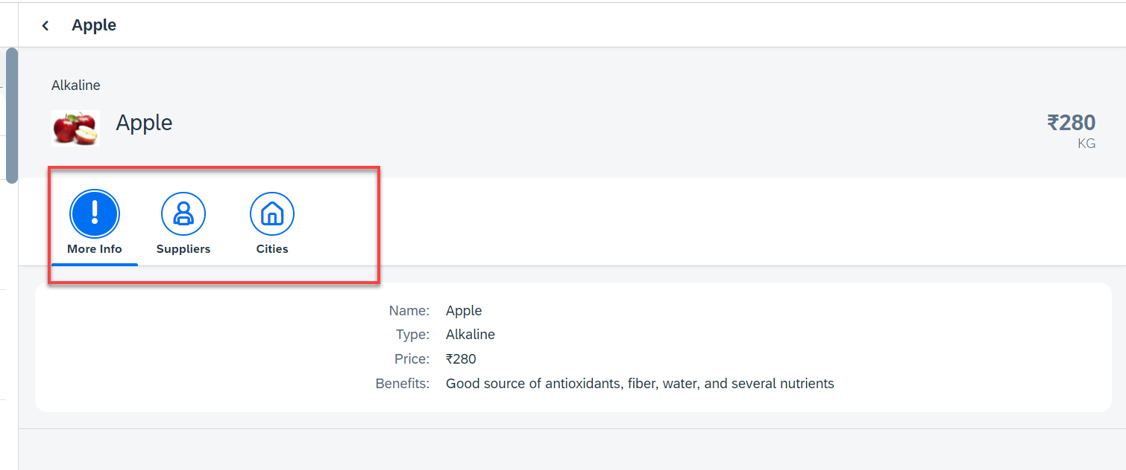
Hands – on: Icon Tab Bar
Now in the View2, we will create a icon tab bar to show the additional data related to the fruits, like Supplier and City data.
For now in the first section we will add a simple form to show the data of fruit.
Code Link:
View2.view.xml

Slide 4
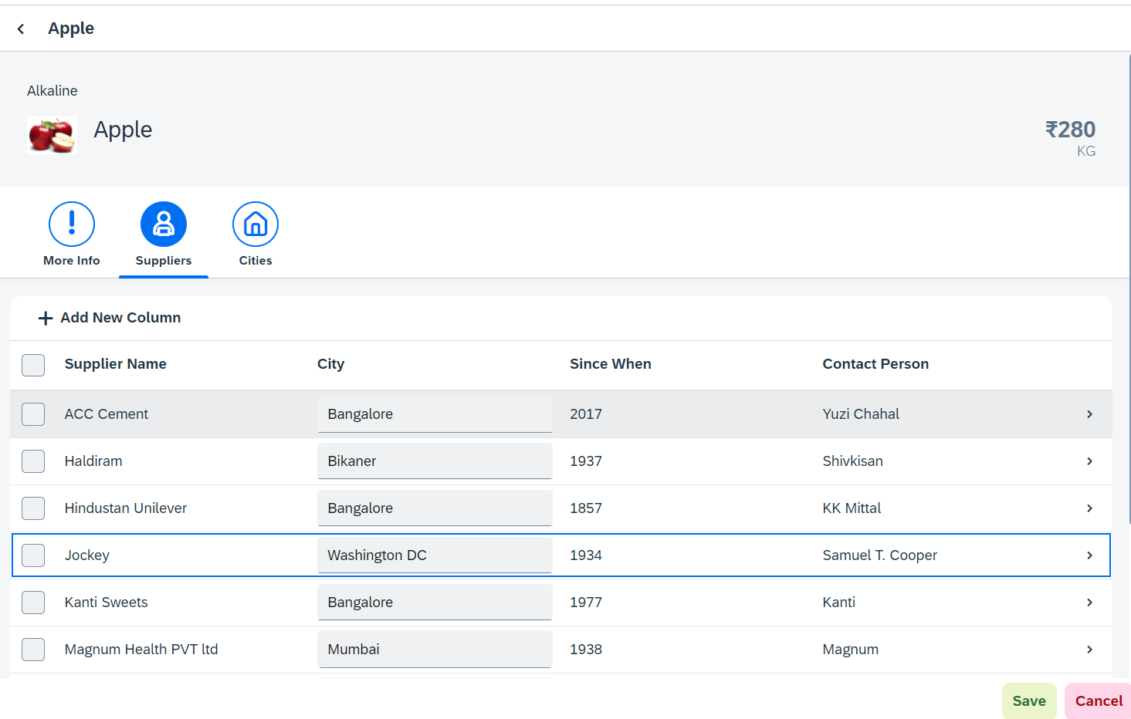
Hands – on: Sap.m.Table (Responsive Table)
Now in the second section of the icon tab filter bar we will add a Responsive table containing the Supplier Data.
Along with that we will add a button in the Header of the table to add a new column.
And on select of a row in the table the table path will be shown in alert message.
Code Link:-
View2.view.xml
View2.controller.js

Slide 5
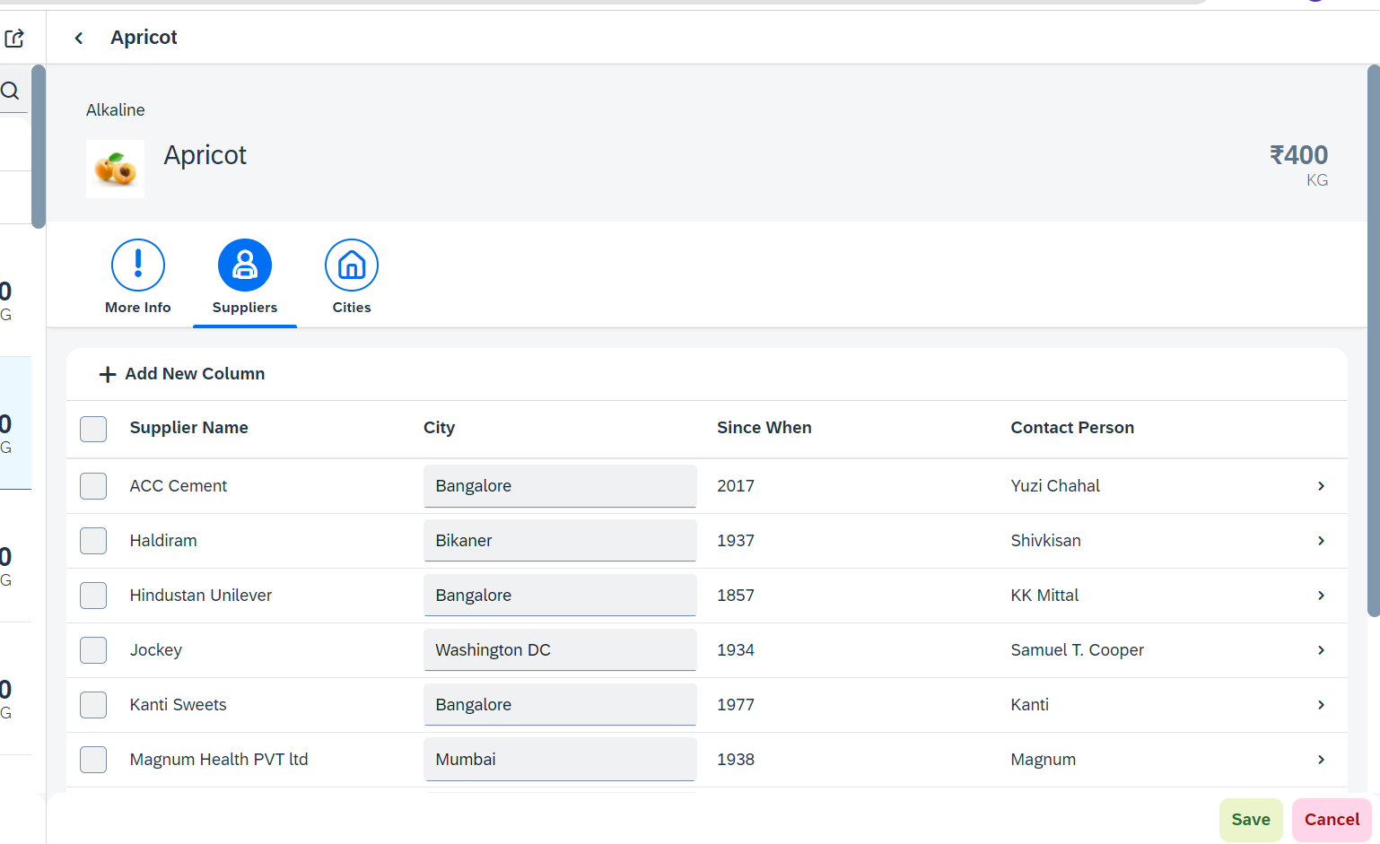
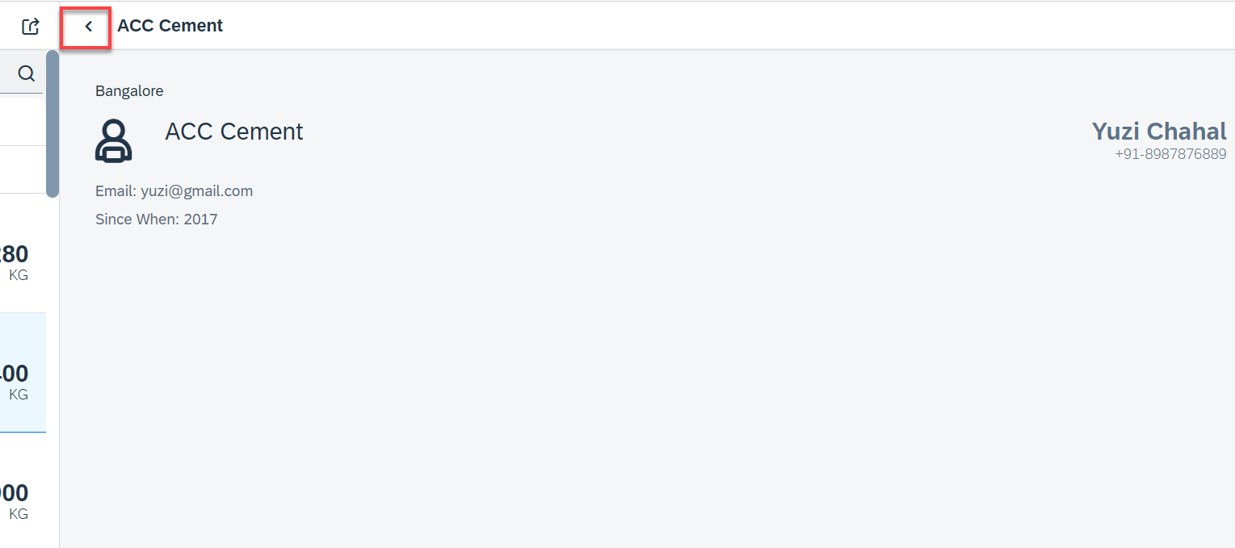
Hands – on: Drill Down from Table and Nav Back
Now we drill down to a new screen where we will show the supplier data for that we will create a new supplier view.
Along with that we will also add the back button login to go back using a nav button on the supplier view.
Code Link:-
View2.controller.js
Supplier.view.xml
Supplier.controller.js
BaseController.js
manifest.js
The nav back logic is written in BaseController so that it can be used at multiple places.

Slide 6
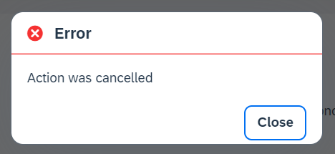
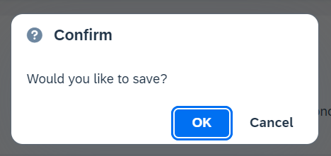
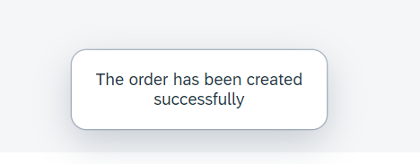
Messages in UI5
The system generates messages in response to what users do in the SAP system. A message presents information, an instruction, or a warning to users in a given situation.
Messages can be used to notify the user about specific states of the application and can help the user to correct their incorrect inputs.
For showing messages to the user that are related to the current page, you have several possible controls. Each of these offers a different type of interaction from the user. Choose the control that fits best in you interaction pattern.
Message Dialog: A message dialog interrupts the user's workflow by blocking the current page and needs to be closed by the user.
Message Toast: A message toast is an overlay that disappears after some time or if the user taps somewhere else. It does not block the user.
Message Box of type error
Message Box of type Confirm
Message Toast

Slide 7
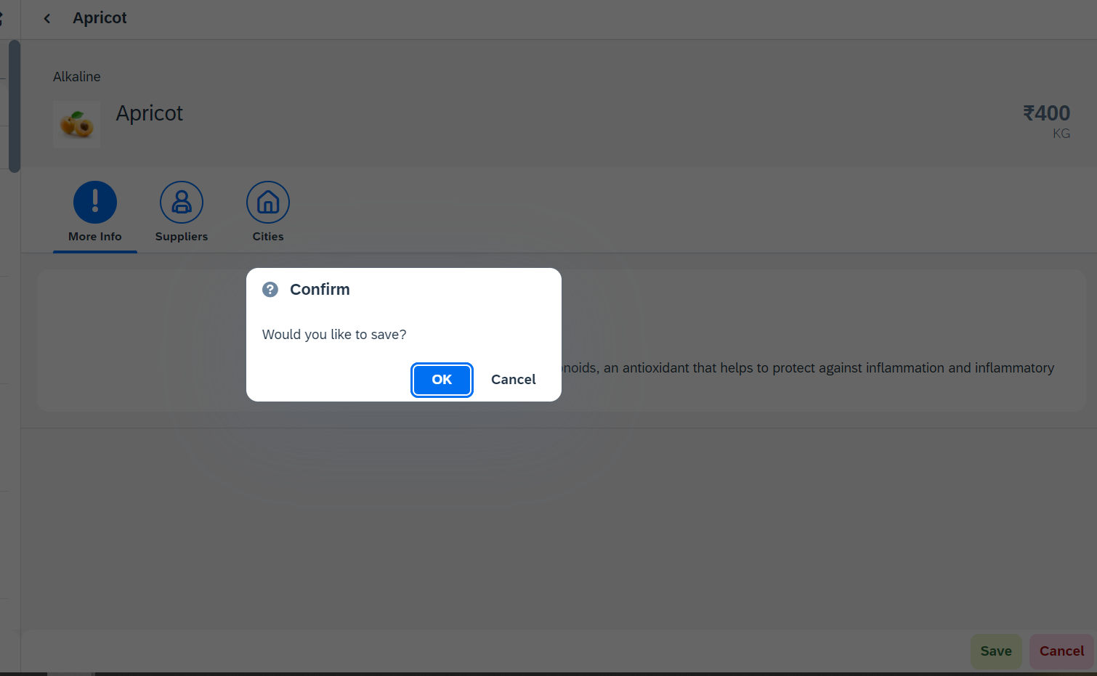
Hands – on: Messages
Now we will see how to use the messages in the ui to get users conformation or to show error to the use.
For this we will see the example of Message Box and Message Toast.
Code Link: -
View2.view.xml
View2.controller.js

Slide 8
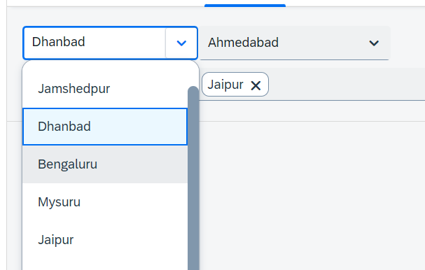
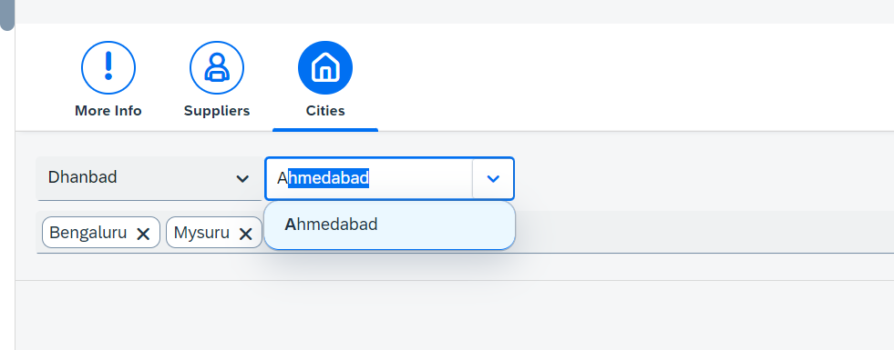
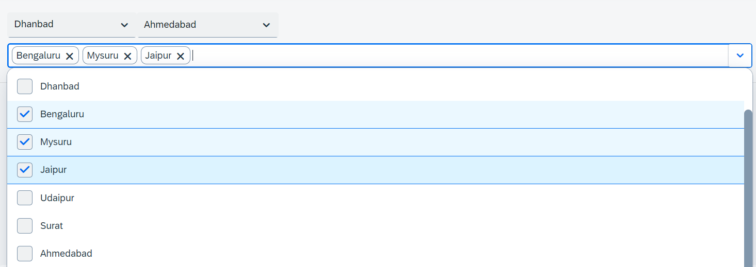
Hands – on: Drop Down Controls
Now we will see the example of some Drop Down Controls present in UI5.
We will load the cities data in the different types of drop downs to see their functioning.
Code Link:-
View2.view.xml

Slide 9
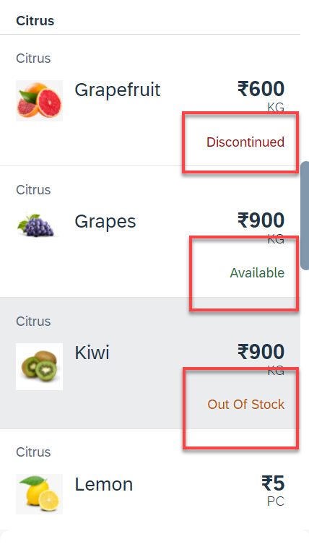
Hands – on: Object Status
Some time we want to show the status any item in different colors, as in our case we want to show the availability of a fruit in different colors like Available, Out of Stock, Discontinued.
For this we will add the object status attribute in the Object list item in View1.
Code Link:-
View1.view.xml
View1.controller.js
formatter.js

Slide 10
Fragments
Fragments are light-weight UI parts. They are used to modularize views. We can reuse a fragment multiple times in same view or other views.
Fragments are used similar as sap.ui.core.mvc.Views, but Fragments do not have their own controllers. Logic related to fragment’s UI elements is written in the host view’s controller.
Fragments are like parasite, they rely on the controllers of the host views.
There are 2 techniques to create and work with fragments
Direct embedding using fragment
Use JS class sap/ui/core/Fragment and use load function to load it
View1
Controller1
Address – street, house, city, country
fragment
B
Event for fragment button
fragment
B
View 2
Controller2
fragment
Event for fragment button
B

Slide 11
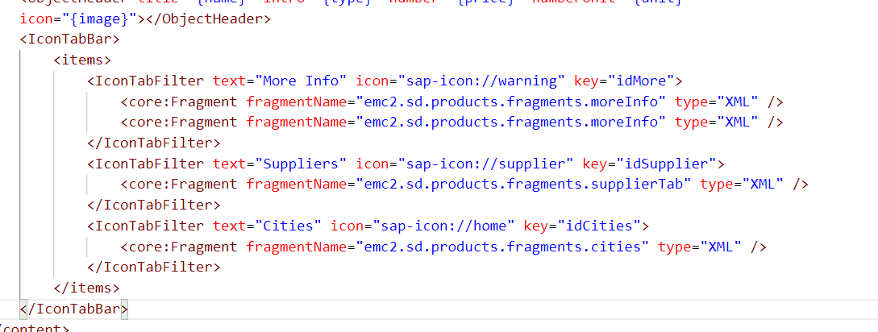
Hands – on: Embedding Fragment in View
For this hands – on we have to create a folder named fragments in the webapp folder and in that folder create fragment files with the extension .fragment.xml.
We will move the Icon Tab bar code to the fragments and will embed them in the View2 to modularize the code of View2.
Create three file in the fragments folder for more Info Section, Supplier Table section and Cities Section.
To including the fragment directly into the XML View use the sap.ui.core.Fragment class as shown below
Ex: <core:Fragment fragmentName=“namespace.fragments.fragmentName" type="XML" />
Code Links:-
View2.view.xml
moreInfo.fragment.xml
cities.fragment.xml
supplierTab.fragment.xml

Slide 12
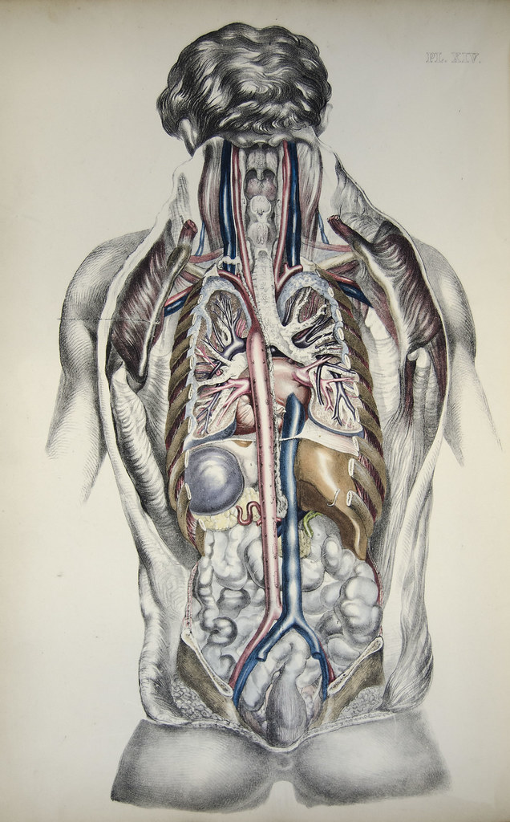


fragment
view
model
This Photo by Unknown Author is licensed under CC BY-SA

Slide 13
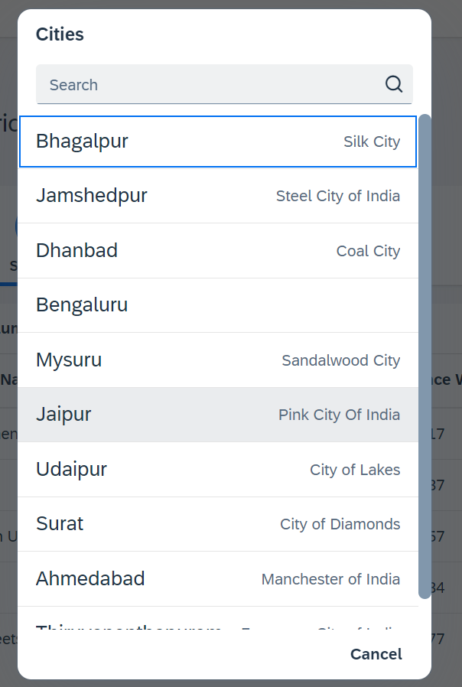
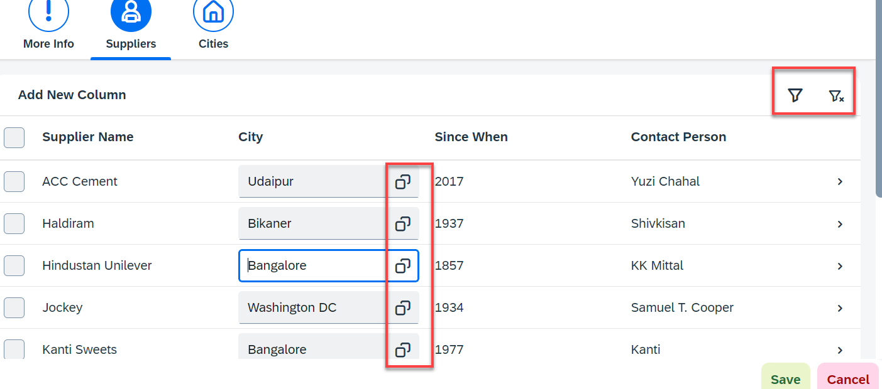
Hands – on: Fragment Use Case 2 (Using JS Code)
My manager asked me to develop following requirements
Add a filter button in the toolbar of the table, and when we click filter icon, it should load a popup with all the list of suppliers. When we select supplier inside filter it should filter data in the table.
Inside the table we have a city field. We would like to enable a value help (F4 Help), when we click on same, it should open a popup which shows all the list of cities on screen.
Part 1: Opening filter popup using the Filter Button.
popup.fragment.xml
supplierTab.fragment.xml
View2.controller.js
Part 2: Opening the Value help popup in the Supplier Table
popup.fragment.xml
supplierTab.fragment.xml
View2.controller.js

Slide 14
Router
Router is an object which is provided by SAP UI5 Component (UIComponent).
It is responsible for creating our view objects on demand.
It is also responsible for complete app navigation based on pattern (end point, hash tag).
How to use router:
Get the router object form the UIComponent class.
Call initialize method using the object
The initialize method will SCAN manifest.json to find the routing configuration (mandatory).
Add the routing configuration in manifest.json
rootView – base view we want to load
config – base configuration like view type, path of all views etc.
routes – array of all the targets, patterns and route names
targets – put all the end point target with views which needs to be instantiated and nav.
Sap.m.routing.Router is the class used for Routing and Navigation purpose in SAP UI5 framework.
“Pattern” defines the hashtag that needs to be added at the end of the URL when it is hit.
“name” defines a unique name for the particular route.
“target” defines the target which is defined in targets section

Slide 15
Routing Configuration
Routing Configuration is defined in manifest.json file. It is defined under the “sap.ui5” section.
Routing configuration consists of routes, targets, config, and owner.
rootView
config
routes
targets
This section contains the information about our Root View. The View which works as a container for other views. In this section we provide the path of the view, type and controlId.
This section contains the global router configuration and default values that apply for all routes and targets. We define the router class that we want to use and where our views are located in the app.
Each route defines a name, a pattern, and one or more targets to navigate to when the route has been hit.
Three subsections :-
1. pattern
2. name
3. target
A target defines a view that is or more routes displayed, it is associated with one.
Subsections: -
Overview
detail

Slide 16
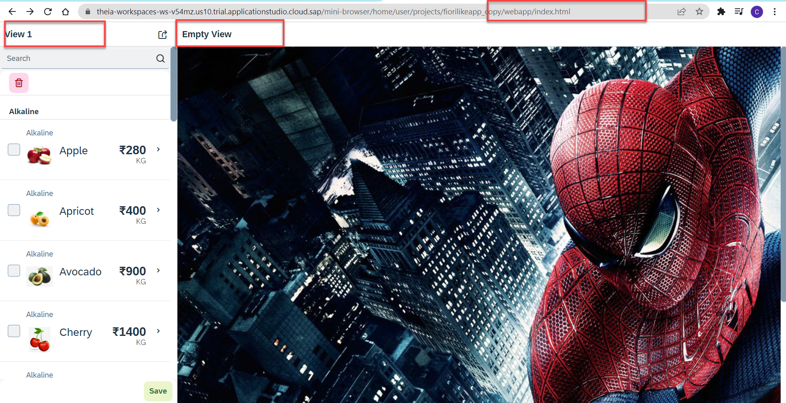
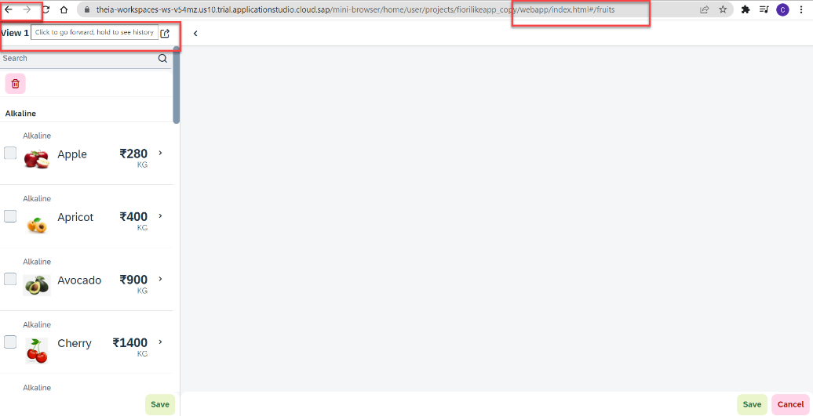
Hands – on: Routing Implementation
Now we need to implement routing in our existing application, for that we have to follow the Steps provided in the previous slides.
We also have to change the navigation in our View1 controller, and make it according to the Router, for that we have to get the router object in the View1 controller and then navigate to the view using the navTo() function.
To get the router object in View1 controller
this.oRouter = this.getOwnerComponent().getRouter();
To navigate to the View2
this.oRouter.navTo("loadMyV2");
Code Links:
manifest.json
Component.js
View1.controller.js

Slide 17
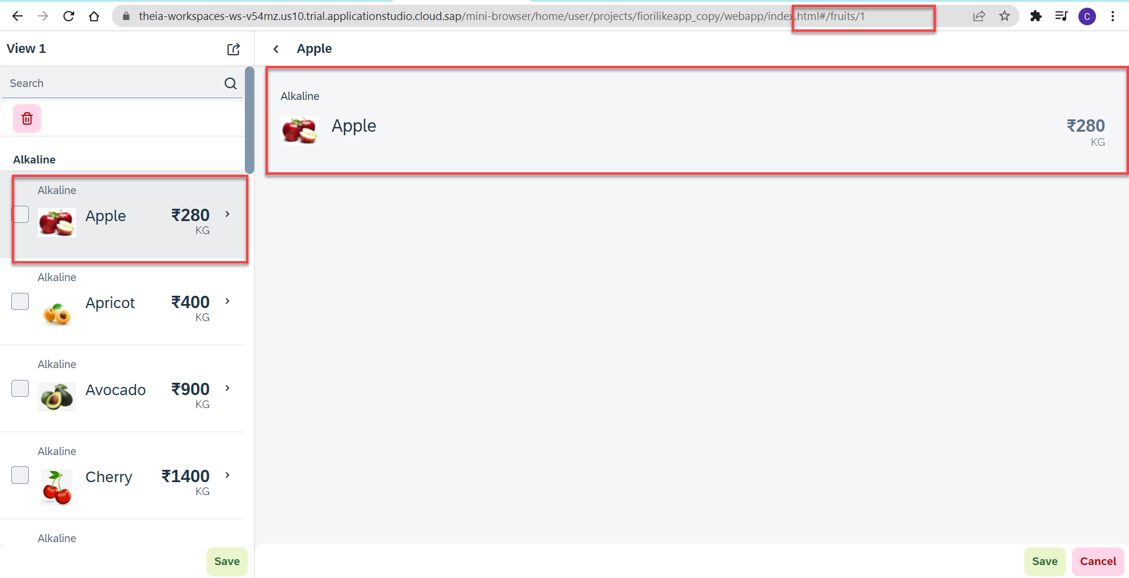
Hands – no: Route Match Handler
Route Match Handler: It is a function which gets triggered every time when Route, End Point, Hash Tag Changes.
Now using the route match handler we will load the data of the selected fruit.
Code Link:-
View1.controller.js
View2.controller.js
manifest.js

Slide 18
What is OData?
OData Stands for Open Data Protocol, It is an stateless protocol; it is an OASIS standard to communicate to server using REST(Represerntational state Transfer) based service. It was acquired by Microsoft in 2012 and adopted by many companies to build REST services to expose data over internet HTTP/HTTPs protocol.
Funda Fox
Fiori cannot talk to FM, program, CDS views, …. Fiori only and only talk to OData service which is built on top of FM, ABAP code, CDS view.

Slide 19
OData Basics
This OData Protocol is mainly used to expose data over HTTP. It does not matter from consumer point, which technology the OData is built on. This way we are abstracted from the underlaying programming/database. Fiori only and only understand OData, it cannot talk to BAPI, BADI, FM, CDS View, Interface, Class.
Lets start understanding a sample odata given by Microsoft on odata.org
1. Service document – is a collection of entity sets to access the data.
An Entity set is built by an Entity Type. Entity Set is the right end point to perform CURDQ operations
Entity Type describes the structure of the data – metadata
https://services.odata.org/V3/Northwind/Northwind.svc/
2. Service metadata document – describes all the properties and entity types
Which includes key, properties, attributes (nullable, key, max length, create), NavigationProperty
Also includes the relations between entities called association (compare with Foreign key)
Usually one database table is considered as one entity.
https://services.odata.org/V3/Northwind/Northwind.svc/$metadata
https://chrome.google.com/webstore/detail/jsonview/chklaanhfefbnpoihckbnefhakgolnmc
https://chrome.google.com/webstore/detail/xml-tree/gbammbheopgpmaagmckhpjbfgdfkpadb

Slide 20

Structure of an OData URL
http://stcfin.st.com:8021/sap/opu/odata/IWBEP/GWSAMPLE_BASIC/ProductSet?$format=json
http(s)://hostname:port/sap/opu/odata/sap/SERVICENAME_SRV/ENTITYSET?p1=val&p2=val
Protocol
Address & Port
Path prefix
Service Name
End Point Access Data
Query Options

Slide 21
Client Side Query with OData
Sets the page size of results.
02
$top
Indexes into a result set. Also used by some APIs to implement paging and can be used together with $top to manually page results.
Returns the results in the specified media format.
01
03
$format
$skip
ODATA Query
06
04
Retrieves related resources.
Filters properties (columns).
$expand
$select
05
$filter
Filters results (rows).

Slide 22
GET operations
Read All the data from Products (SELECT * FROM dbtab)
https://services.odata.org/V3/Northwind/Northwind.svc/Products?$format=json
Read few properties of entity (SELECT col1, col2 FROM dbtab)
https://services.odata.org/V3/Northwind/Northwind.svc/Products?$format=json&$select=ProductID,SupplierID
Read Top Records (Pagination SELECT * UP TO ROWS n ..)
https://services.odata.org/V3/Northwind/Northwind.svc/Products?$format=json&$top=3&$skip=10
Read data by filtering (SELECT * FROM dbtab WHERE condition)
https://services.odata.org/V3/Northwind/Northwind.svc/Products?$format=json&$filter=SupplierID%20eq%203
SELECT * FROM dbtab WHERE col LIKE ‘%pattern%’
https://services.odata.org/V3/Northwind/Northwind.svc/Products?$format=json&$filter=substringof(%27Cola%27,ProductName)%20eq%20true
Reading count of the records (SELECT COUNT(*) FROM dbtab)
https://services.odata.org/V3/Northwind/Northwind.svc/Products/$count
Reading Single record by its key (SELECT SINGLE * FROM edbtab WHERE pkey = ‘key’)
https://services.odata.org/V3/Northwind/Northwind.svc/Products(11)?$format=json
Join and read data together (SELECT * FROM tab1 INNER JOIN tab2 ON cond)
https://services.odata.org/V3/Northwind/Northwind.svc/Products(11)?$format=json&$expand=Supplier,Category
Association : It’s the relation between multiple Data , it is similar as foreign key relation in DB world
When we create association system will create the navigation property which we can use as a pointer to load the dependent data.

Slide 23
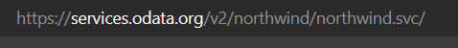
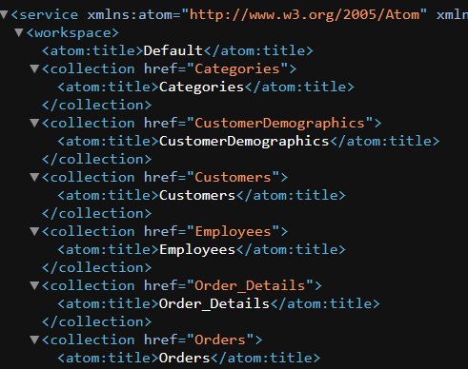
Hands-on : Get Operations
Practice all the get operations in the previous slide by your own on the northwind service url.
Links were given in the previous slide.

Slide 24
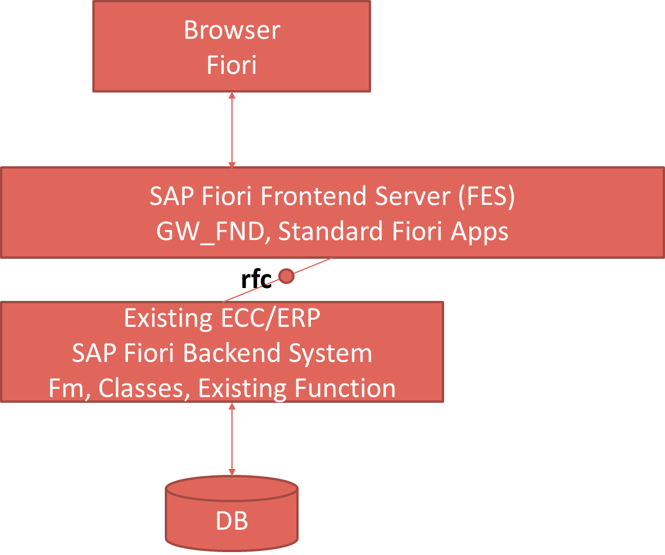
SAP Deployment Options
Central HUB Scenario
Embedded system
Browser
Fiori
SAP Fiori Frontend Server, GW_FND, Standard Fiori Apps
Existing ECC/ERP
SAP Fiori backend System
FM , Classes, existing Function
DB

Slide 25
Pros and Cons
Central HUB Deployment
Cons:
Manage multiple systems
Cost is high
Confusion
User needs to be duplicated
OData Metadata is duplicate
Pros
No need to upgrade
Separation of concerns
Works like a HUB
Recommendation
https://www.sap.com/documents/2018/02/f0148939-f27c-0010-82c7-eda71af511fa.html
Embedded Deployment (recommended)
Pros –
Less Costly
No confusion
No redundancy
Cons –
- Upgrade
- All load on one system

Slide 26
TCodes and Service
SEGW – SAP Service Gateway Builder
/n/IWFND/MAINT_SERVICE – Register the service
/n/IWFND/GW_CLIENT – gateway client – test locally
/n/IWFND/ERROR_LOG – Check errors, troubleshoot
EPM – Enterprise procurement model – Demo data model given by SAP for Training and demonstration.
ITeIO
SO
Customers
PO
Suppliers
Invoices
Stock

Slide 27
Data Model for our use case
EPM Data model = Enterprise Procurement Model
This is a sample data model for learning and education purpose since it is a demo model, we are not risking any productive objects in our system. The data model has Function Modules called as BAPI(Remote enabled FM).
All the BAPI starts with BAPI_EPM*
Products (SNWD_PD, SNWD_TEXTS)
BAPI_EPM_PRODUCT_GET_LIST – All the list of products
BAPI_EPM_PRODUCT_GET_DETAILS – Read single product by key
BAPI_EPM_PRODUCT_CREATE – Create new product
BAPI_EPM_PRODUCT_DELETE – Delete product
BAPI_EPM_PRODUCT_UPDATE – Change data of a product
Business Partners (SNWD_BPA)
BAPI_EPM_BP_GET_LIST – All the list of Business Partners
BAPI_EPM_ BP_GET_DETAILS – Read single Business Partners by key
BAPI_EPM_ BP_CREATE – Create new Business Partners
BAPI_EPM_ BP_DELETE – Delete Business Partners
BAPI_EPM_ BP_UPDATE – Change data of a Business Partners
Orders (SNWD_SO, SNWD_SO_I)

Slide 28
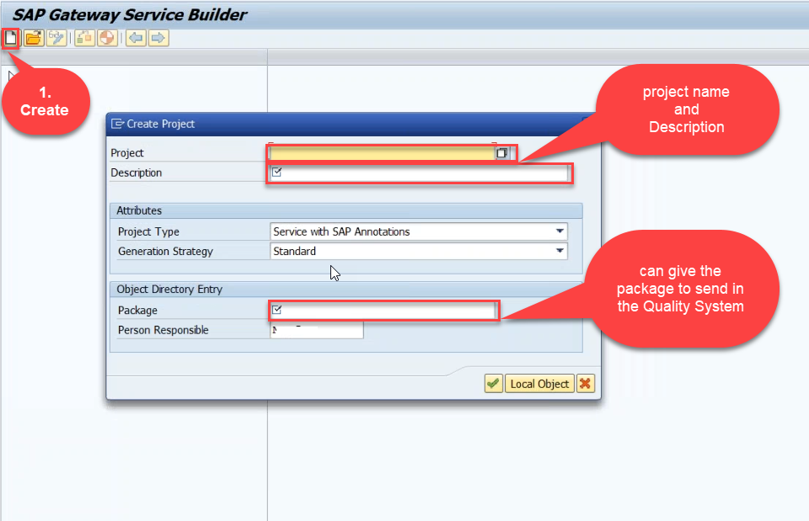
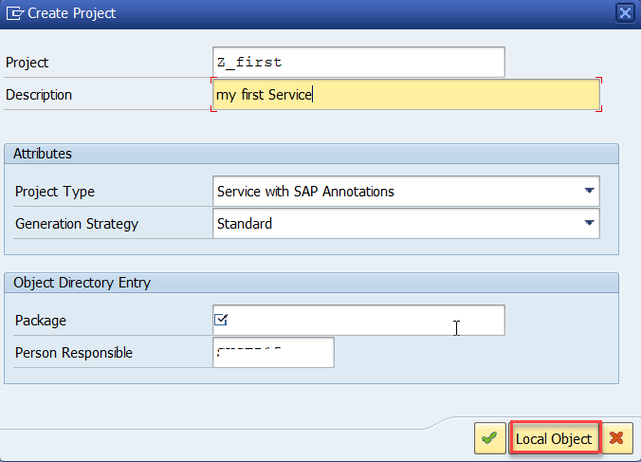
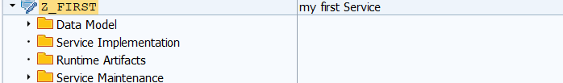
Creating OData Service Project
Step1: Start your SAP LOGON, and to Sap Gateway Service Builder(SEGW) and click on Create

Slide 29
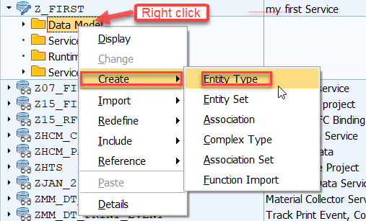
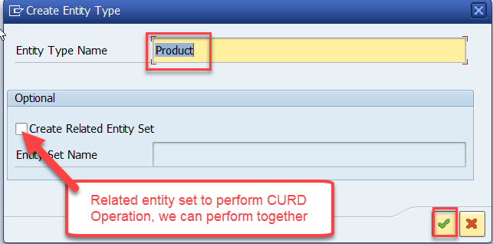
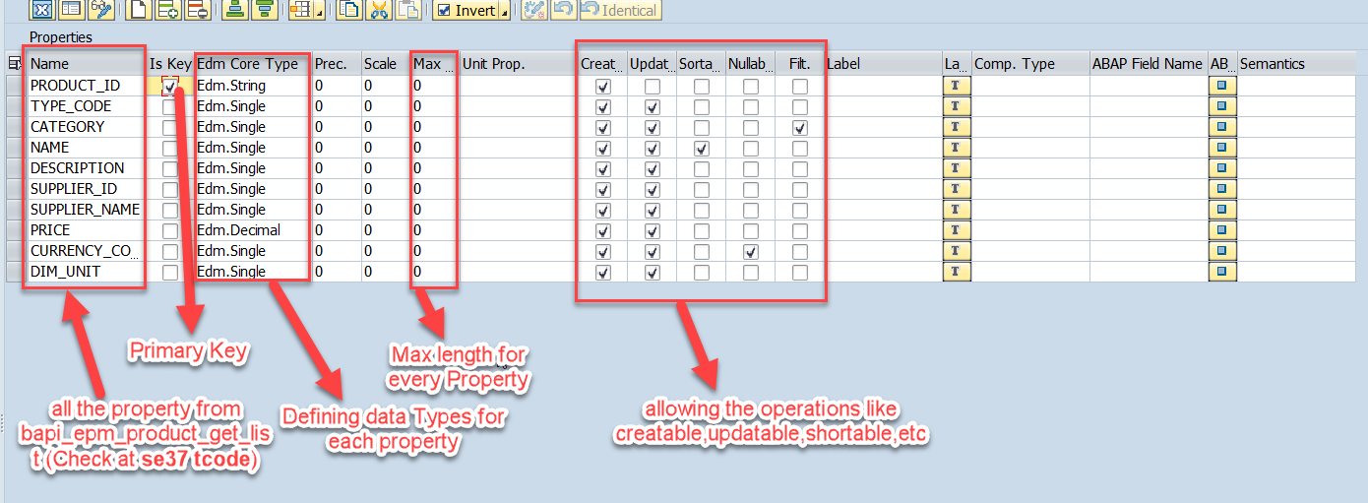
Creating OData Service Continue…
Step2: Defining the Data Model (Blueprint of data)
Step3: Creating Properties for data model (from bapi_epm_product_get_list (TCode- se37))

Slide 30
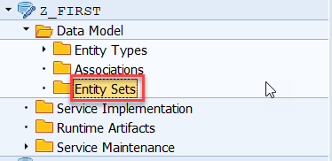
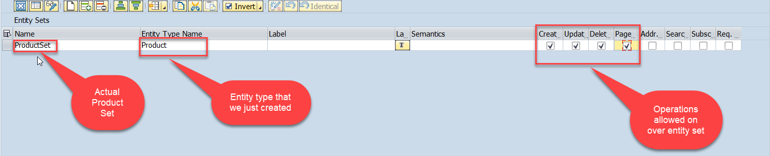
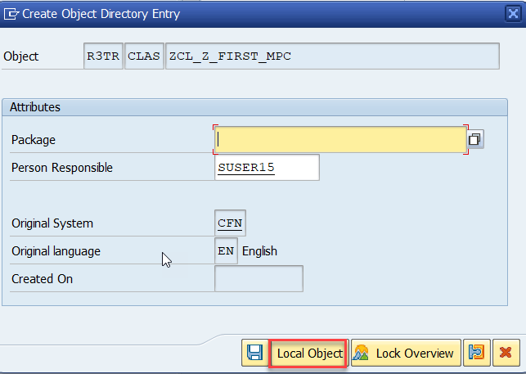
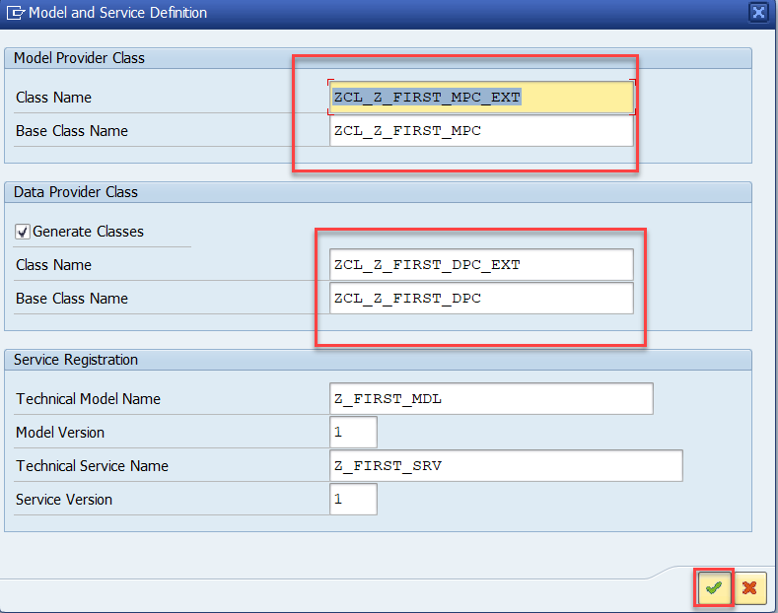
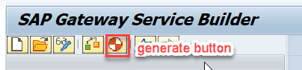
Creating OData Service Continue…
Step4: Creating entity set to perform actual CURD operations and service generation.
This is the name of your service

Slide 31
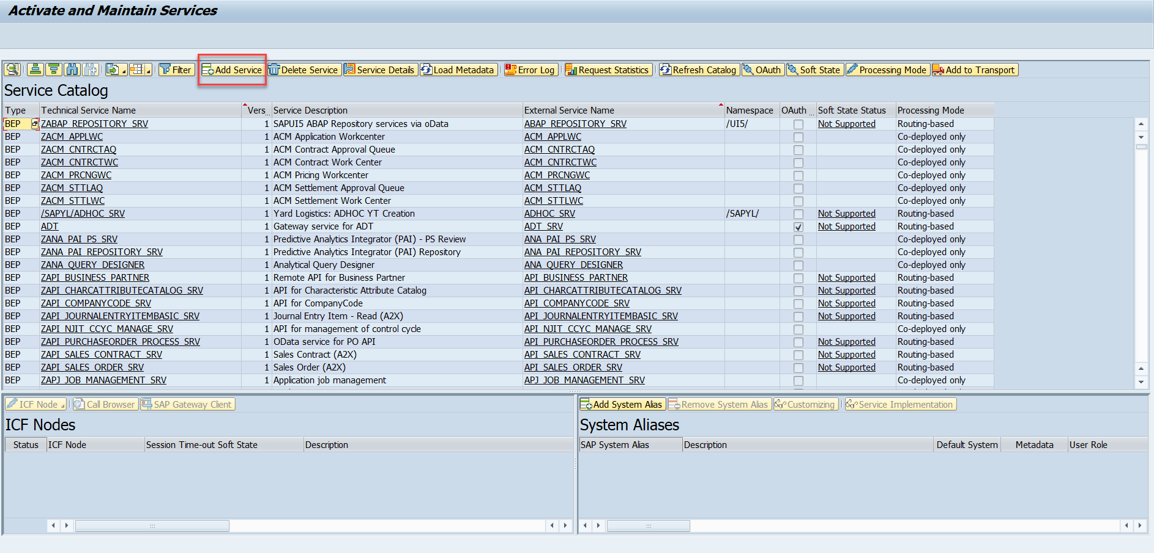
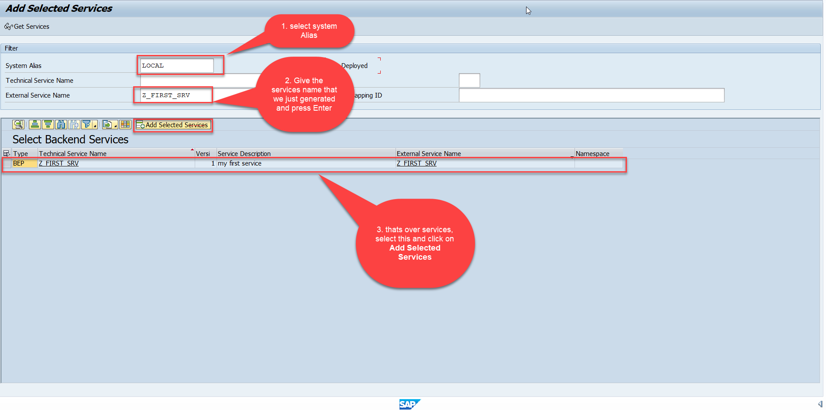
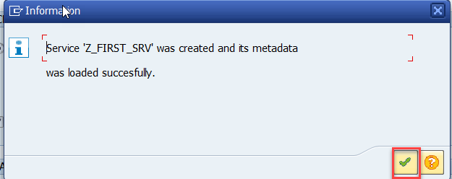
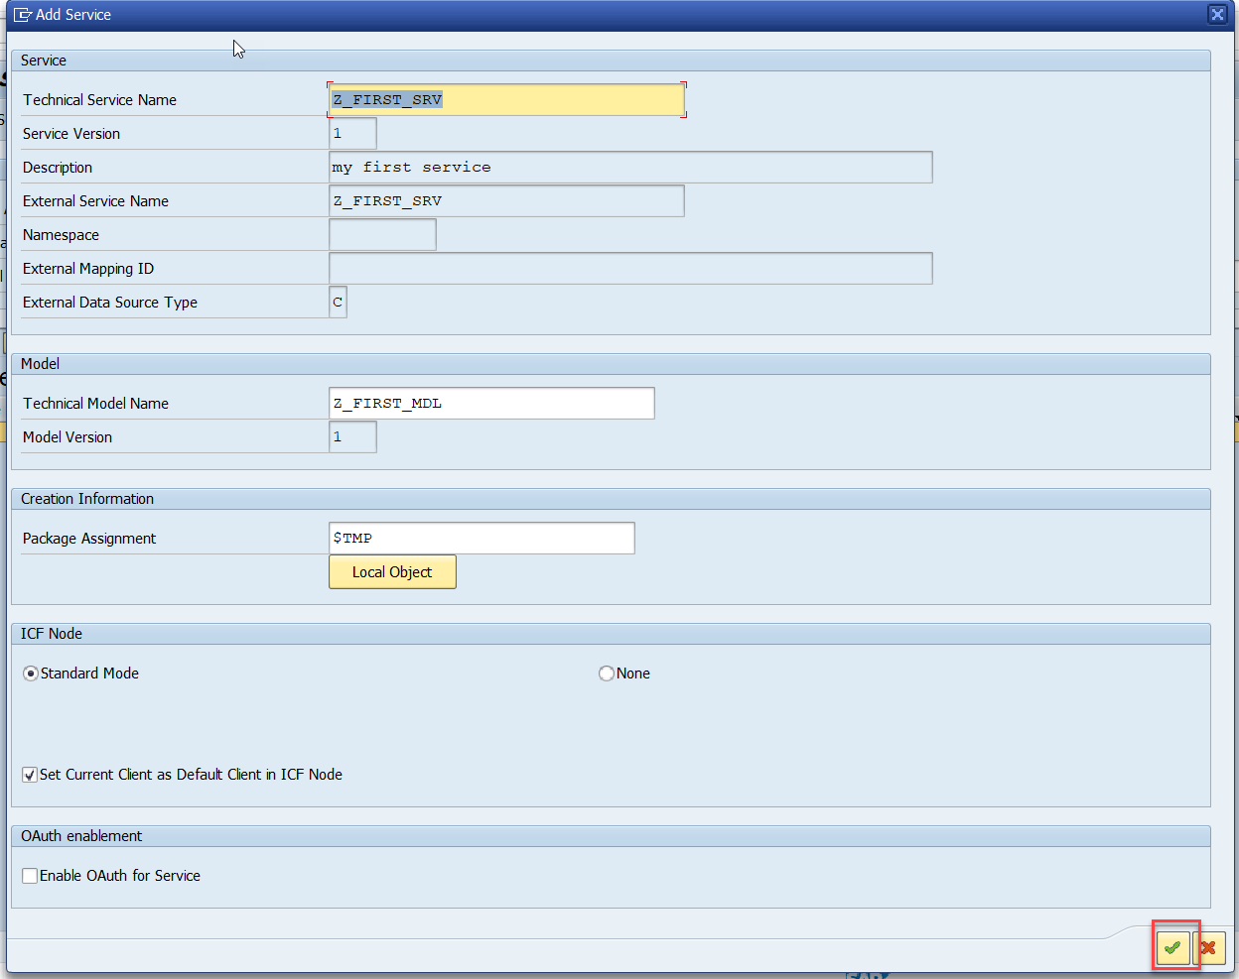
Creating OData Service Continue…
Step5: Service Registration (Go to tcode- /iwfnd/maint_service)

Slide 32
Hands-on: Creating First OData Service
Create your own first OData Service by following the steps written in the previous Slides.

Slide 33
Runtime Artifacts
When we create a service there are 2 types of code which developer/system needs
Metadata code – which serve metadata of the service, it will be generated by system automatically every time we change the service a new code will generate overwriting old code by SAP. This code is generated in MPC – model provider class
MPC = Model Provider Class (metadata) = where all the abap code will be generated which will have the code for metadata
Service Code – which is required as service implementation for performing CURDQ functionality. This code will be written by developer in a class called DPC = Data provider class.
DPC = Data Provider Class (data operations CRUDQ) = Contains all the implementation of CURDQ. It will get for each entityset 5 methods.
What if a developer need to customize the SAP generated code
SAP
Model provider class MPC class
Data Provider class
DPC class
Metadata
Types of entities
Whenever a entitySet is created, in Each entity 5 methods will be created –
OBJECT_GET_ENTITYSET
OBJECT_GET_ENTITY
OBJECT_CREATE_ENTITY
OBJECT_UPDATE_ENTITY
OBJECT_DELETE_ENTITY
PROJ_SRV
MPC_EXT
Here we should write our code
DPC_EXT
CURD Functionality

Slide 34
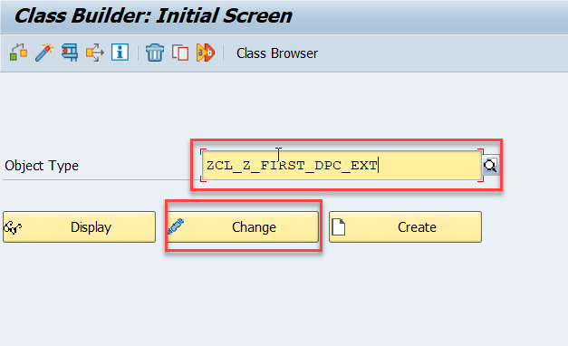
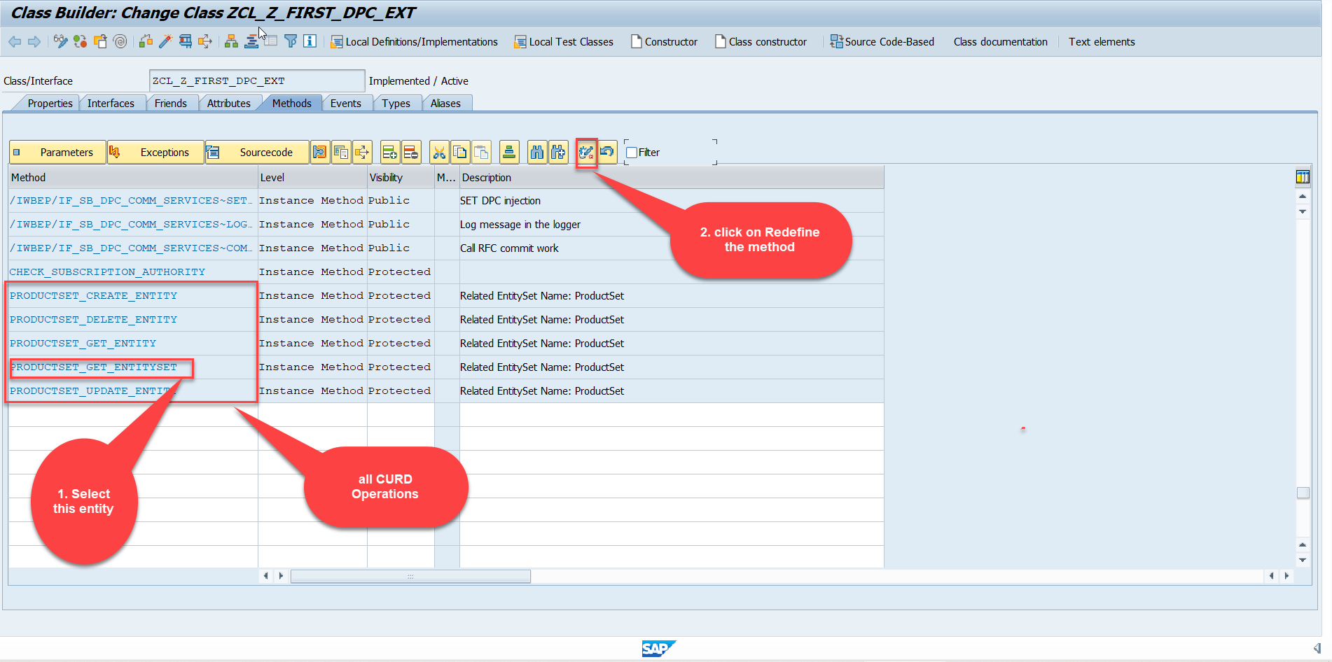
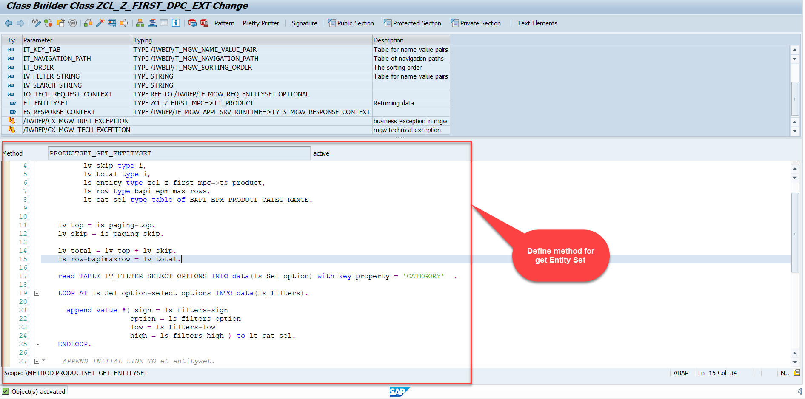
Building Get Entity Set Method for ProductSet
ProductSet Get EntitySet method(with filter, top and skip) in DPC Extension (Class Builder tcode- se24)
After adding the code just activate the service.
Code for PRODUCTSET_GET_ENTITYSET:
GetEntitySet

Slide 35
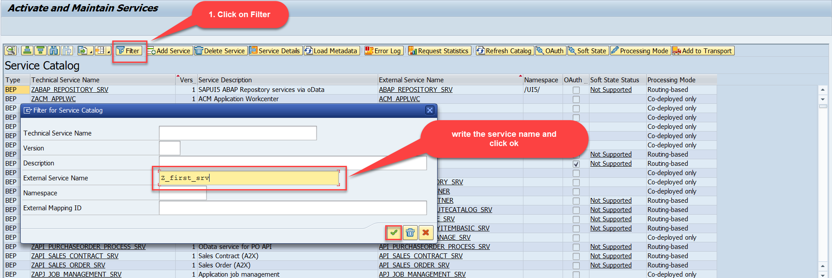
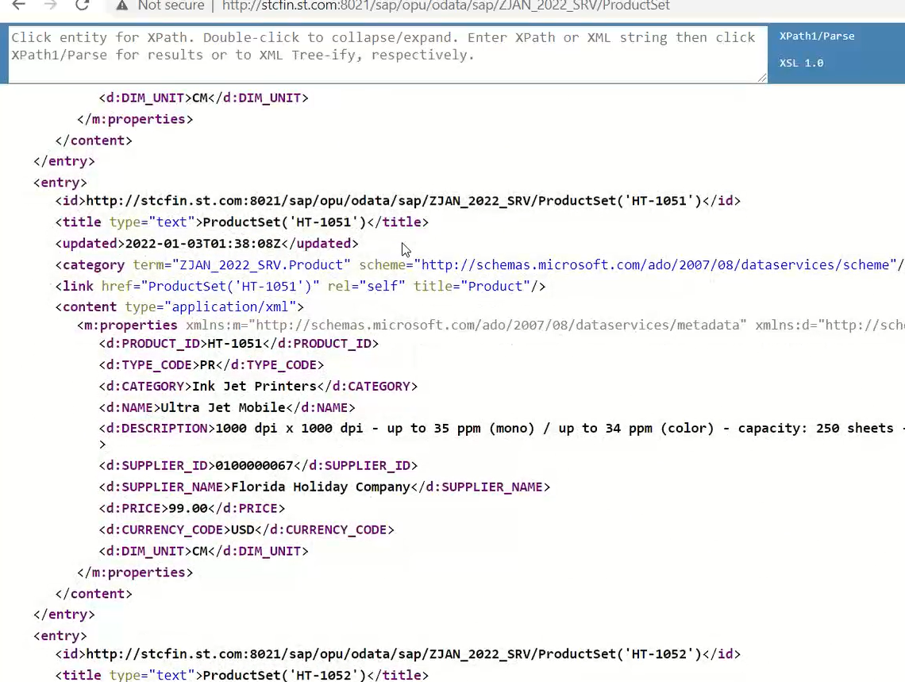
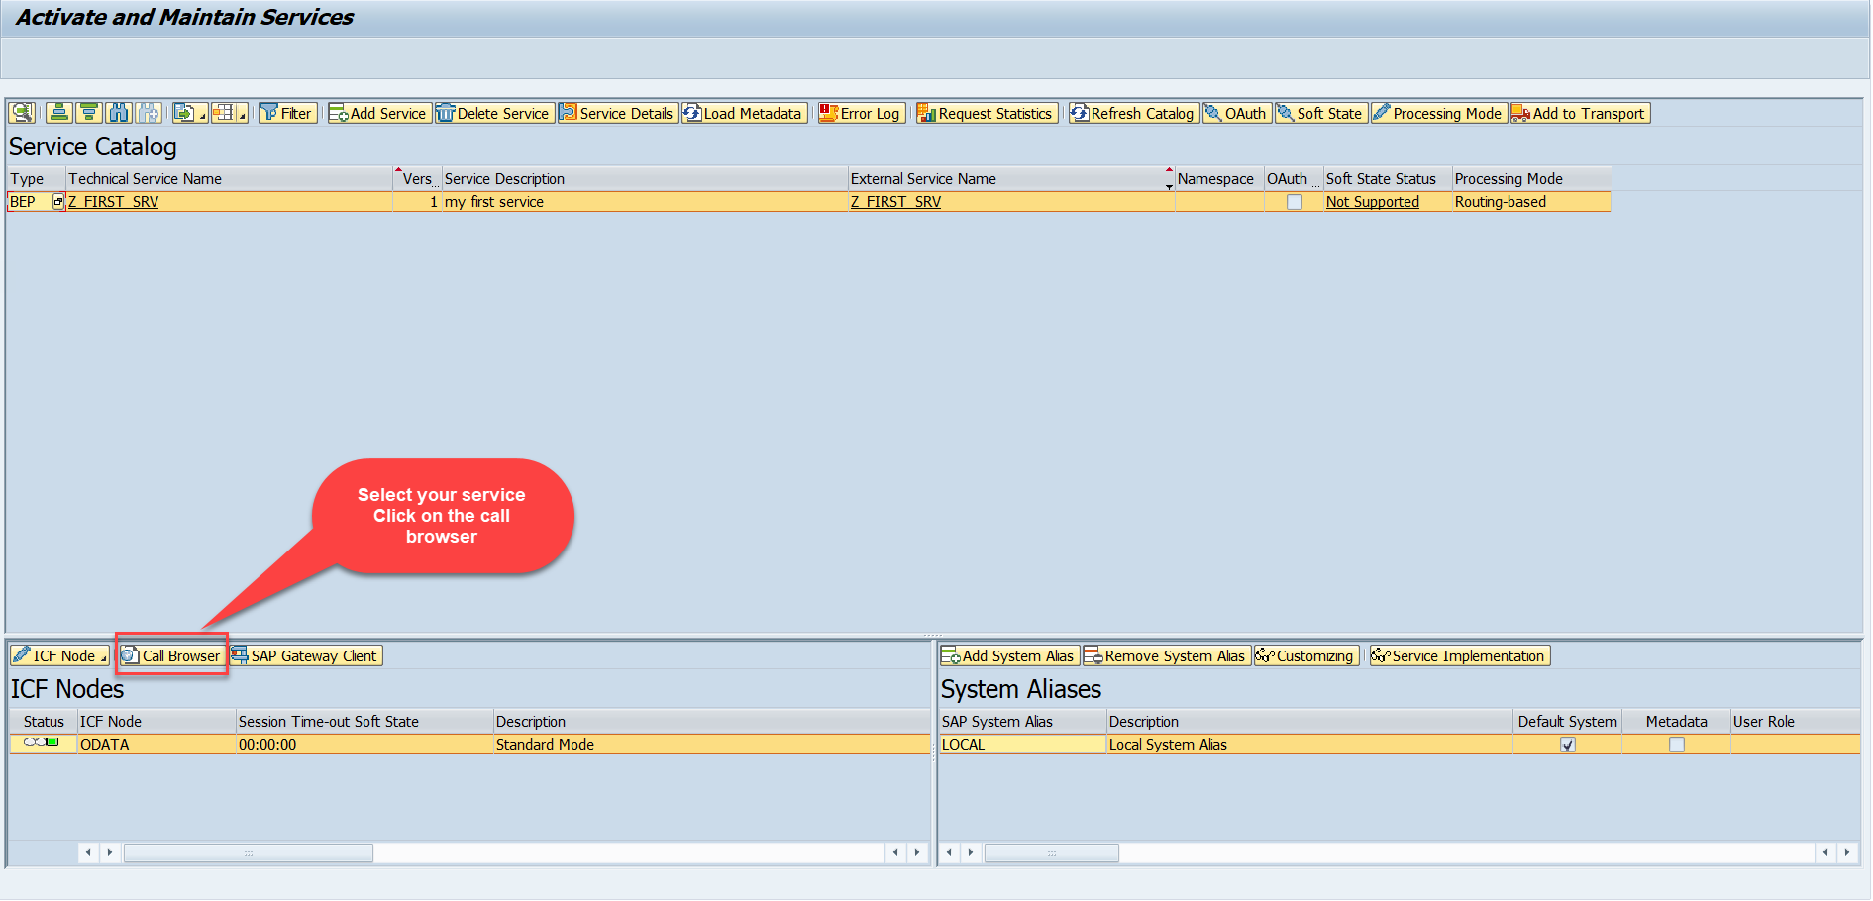
Test the Get Entity Set in Browser
Now enter the Tcode - /n/iwfnd/maint_service and, there search our service using the filter option.
Now select the service and press the Call Browser button to open it in the Browser window.
Just add /ProductSet at the end of the service to call the get product get entity set method
Calling the ProductSet in browser

Slide 36
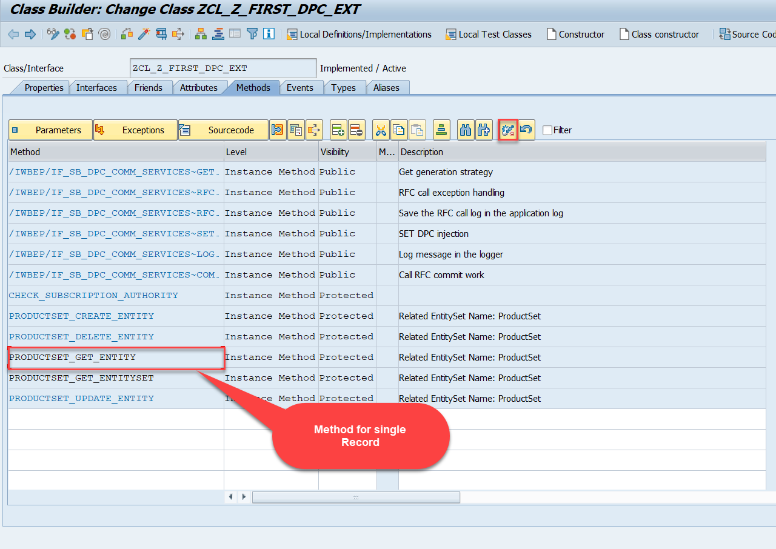
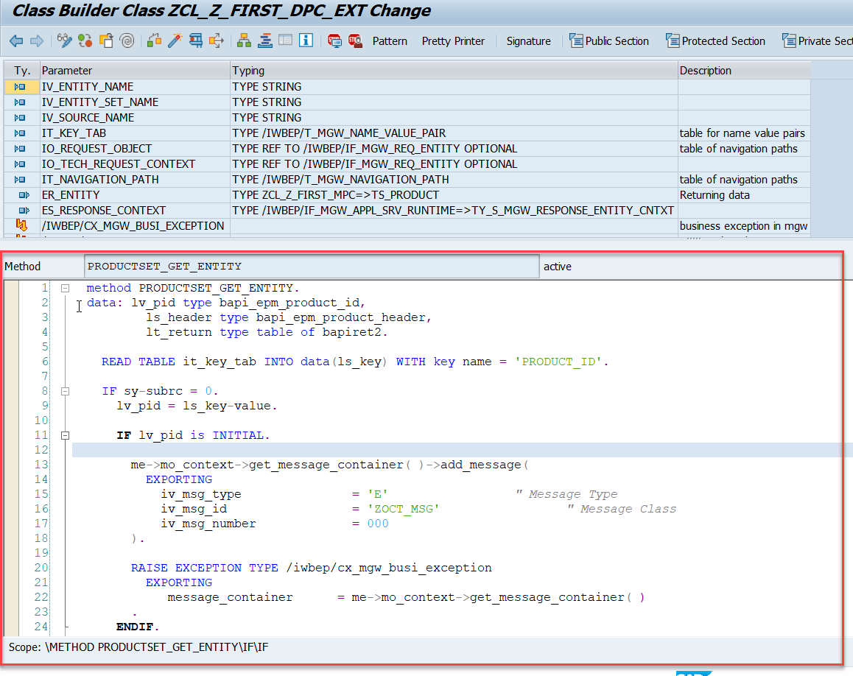
Building Get Entity Method
Go to DPC Extension class of our service and redefine the method PRODUCTSET_GET_ENTITY and put the below provided code.
Code for PRODUCTSET_GET_ENTITY:
GetEntity

Slide 37

Postman
Postman is a free tool which can be used to test any kind of REST/OData Services outside of the system. This allows us to consume the data as if an external consumer would really do.
Postman is an API platform for building and using APIs. Postman simplifies each step of the API lifecycle and streamlines collaboration so you can create better APIs—faster.
As an ABAP developer, you can develop postman collection and deliver it to Fiori Developers for consumption to showcase, what our service is capable of.
Postman can run GET, POST, PUT, PATCH, MERGE, DELETE, and various other request methods as well, and has utilities to help with developing APIs. Free and paid versions are available for Mac, Windows, Linux, and as a Chrome app.
You can Download the postman tool from the link give below: https://www.postman.com/downloads/

Slide 38
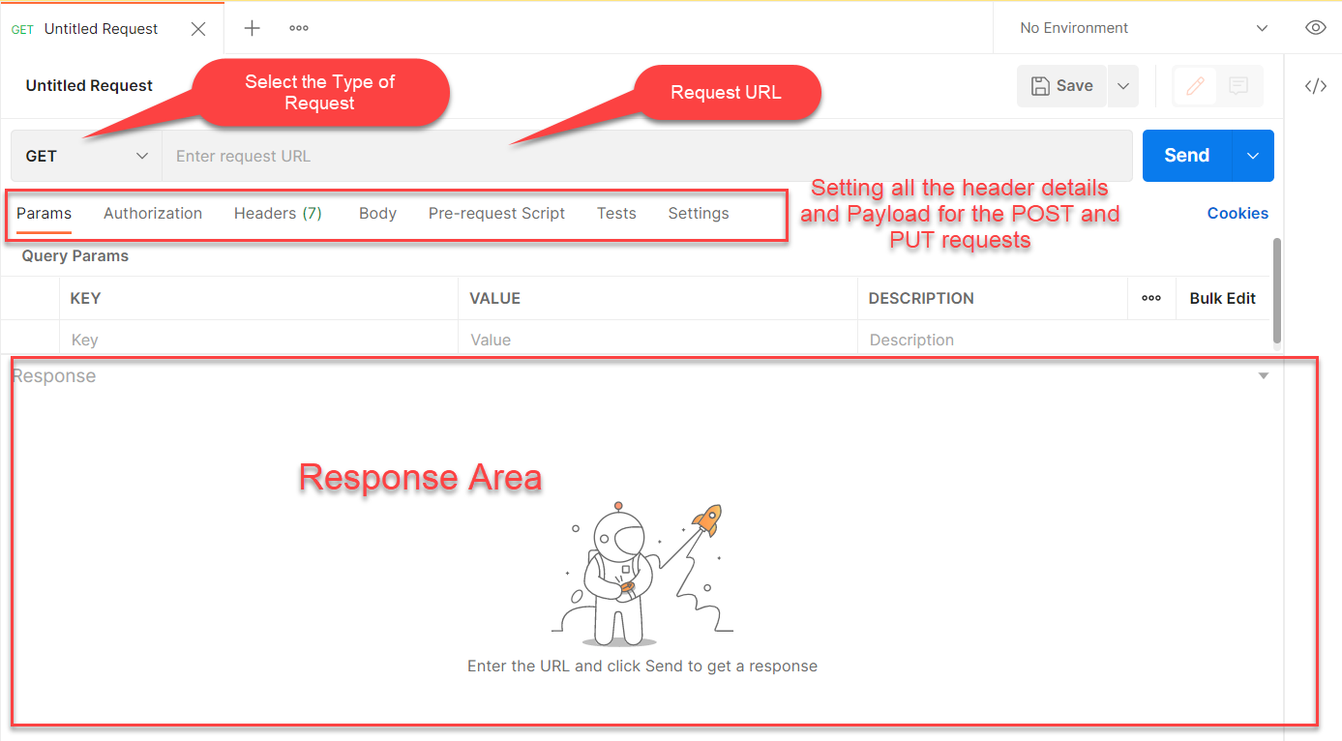
Postman App Layout
The below screen shot shows a basic layout of a request in Postman

Slide 39
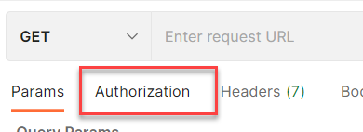
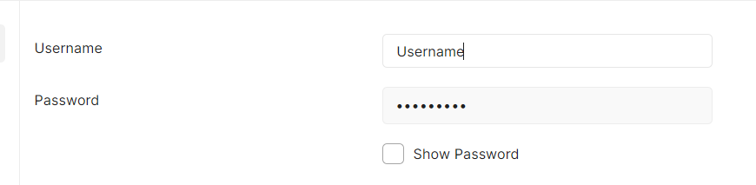
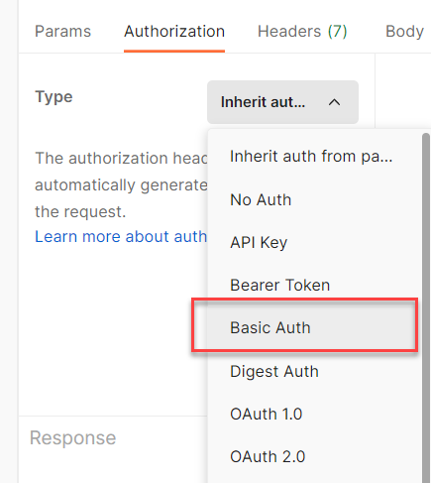
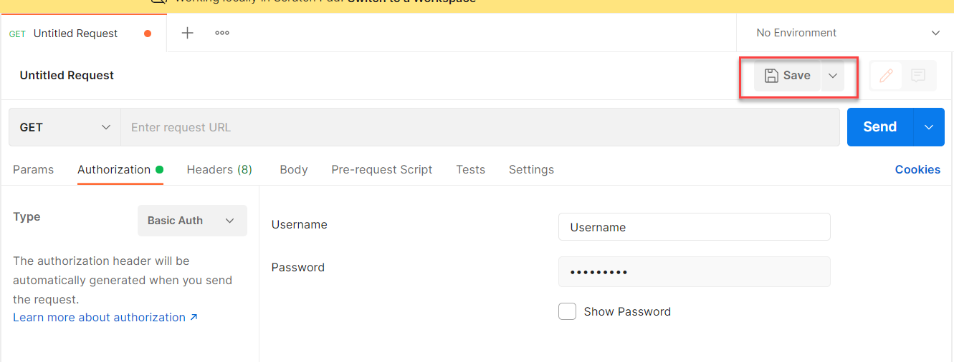
Setting Basic Auth in Postman
Step 1: Go to the Authorization section.
Step 3: Set the Username and Password.
Step 2: Select Basic Auth as Type
Step 4: Save.

Slide 40

End of Day 9

Slide 41

Questions

Slide 42

Shekhar Vedi

Slide 43


We’re committed to empower you to be
Most Desirable Resource
through powerful training solutions.
We build the workforce of the future.
250+
Corporate Clients
30,000+
Learners Trained
25000+
Learners Placed
FREE WEBINARS
Sign up for free webinars with industry experts every fortnight!
Enroll Now!
Contact us today!
https://anubhavtrainings.com/

Slide 44




More from AnubhavTrainings.com

Slide 45
Title
Content

